Slide 1
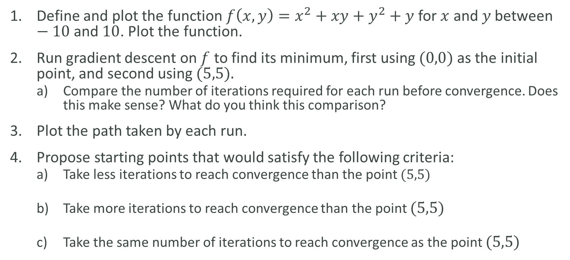
LAB
Define and plot the function $f\left(x,y\right)=x^{2}+xy+y^{2}+y$ for $x$ and $y$ between $−10$and $10$. Plot the function.
Run gradient descent on $f$ to find its minimum, first using $(0,0)$as the initial point, and second using $(5,5).$
Compare the number of iterations required for each run before convergence. Does this make sense? What do you think this comparison?
Plot the path taken by each run.
Propose starting points that would satisfy the following criteria:
Take less iterations to reach convergence than the point $(5,5)$
Take more iterations to reach convergence than the point $(5,5)$
Take the same number of iterations to reach convergence as the point $(5,5)$

